Slide 1
Session 7– Sankhya & Vaisheshika
(Psychology : 3 types of Natures: Applications)
1) Application of the three types of Natures. : Varnas
2) Impact on consciousness &
role of free will v/s conditionings.

Slide 2
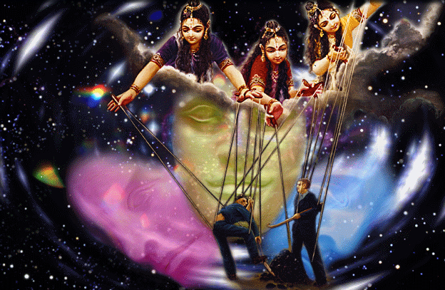

Slide 3
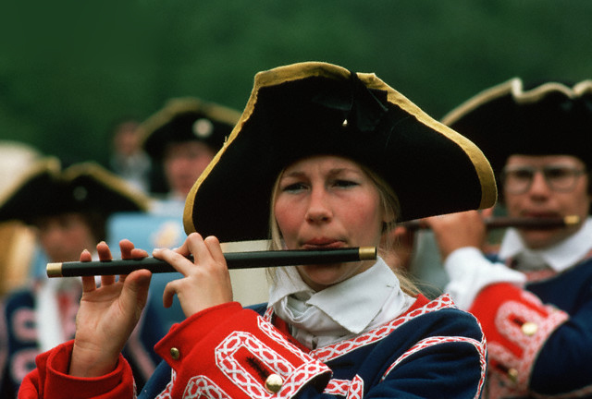
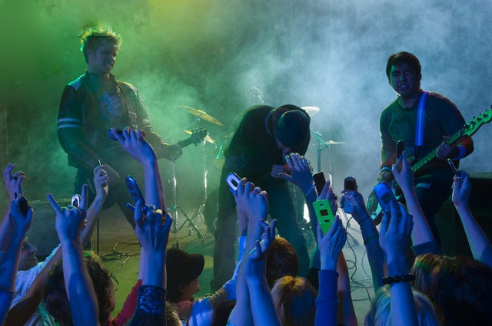

3 Modes (chains) of Material Nature - Music
Goodness
Passion
C
Ignorance

Slide 4
GUNA | SATTVA | RAJAS | TAMAS
Outlook | Detachment | Desire | Ignorance
Motive | Knowledge | Enjoyment | No goal
Mentality | Peaceful | Active | Irrational
Future | Upper worlds | Earth | Lower worlds
Food | Vegetable | Animal vegetable | Animal
Health | Long term | Short term | Destructive
Worship | Desireless | Motivated | Concocted
Knowledge | Atma | My body + others | My body
Action | Selfless | Motivated | Violent
Values | Values based on truth, scripture | Self-centered values | False values

Slide 5
Analyzing the situation by understanding the working of the modes of nature.

Slide 6
Passion | Goodness |  | Ignorance
The three-fold psychological typology
hankering and longings that impel strenuous efforts to obtain objects of desire | detached, dispassionate and interested in knowledge for its own sake | apathy, indifference, obliviousness, and bewilderment
Example

Slide 7
Passion | Goodness |  | Ignorance
Consciousness
Excited and narrowly focused upon the object of desire. | Alert and attentive (towards nearly any subjects presented) and, at the same time, detached and disinterested. | Unaware, inattentive, easily distracted, and disposed toward chronic misperception

Slide 8
2 Applications of 3 modes
1st Varna..
  What is varna
    Literally --- Color
    Jati
  What decides Varna or Jati??
  Varna is determined by
    Guna – Quality (Psychology)
    and Karma – Activity/ work
  Activity/ work is actually deciding factor
  What about birth??
  Chatur varnyam…. Guna Karma vibhagashah

Slide 9
Purpose of varnas is to help cooperation..
Today it is only competition and selfishness
  Honor Killing
  Fighting for reservation (Eg. jat maratha patel)
  Cast bank politics
  How did this situation come about
    British
Again Purpose of varnas is to help cooperation..

Slide 10
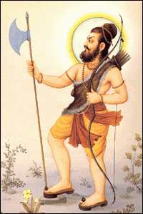
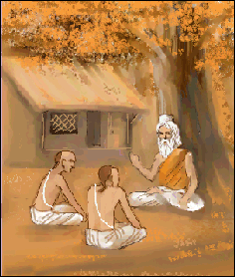
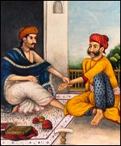
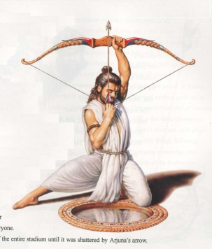
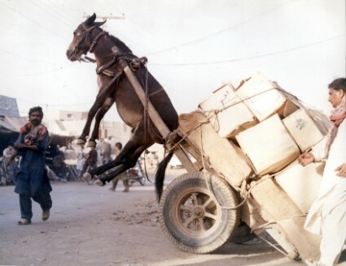
Passion | Goodness |  | Ignorance
The Varnas: Occupational Groups
Just as the human body is equipped by nature with head, arms, belly, and legs, so the social body is constituted in the same natural way by the four occupational groups: the brahmanas who comprise the thinkers and teachers ;the ksatriyas, the governors and protectors; the vaisyas, the producers and traders ; and the sudras, the workers and general assistants

Slide 11
Varna system apprantly similar to European sysetm
  Pope
  Bishop
  Kings
  Lords and Knight
    Origin of “Lords stadium”
  Vassals Villans (one who lives in village
  Serfs / Slaves
  Feudal system (Loyalty system)
  Nobody had independence
  Eg If knight sold the land all the serfs were automatically sold
  Even lords were not free if they disobeyed there would be fight
  Even if king disobeyed the Pope he would call another king to fight with him
  Completely different from Indian System
  Had independance

Slide 12
VARNAS: BY WORK & QUALITY (BG 4.13) All are required!!
Brahmanas
Kshatriyas
Vaishyas
Sudras
Functions: Intelligent class of priests /teachers & advisors
Functions:
Martial /administrative class of statesmen soldiers
Functions: Mercantile class like farmers and merchants
Functions: Laborer class like craftsmen and working men.
Qualities: Peacefulness, self control, austerity,purity, tolerance, honesty, knowledge, wisdom & religiousness
(B.G. 18.42)
Qualities:
Heroism, power, determination, resourcefulness, and courage in battle, generosity, and leadership.
(B.G. 18.43)
Qualities:
Farming, cow protection, and businessmen
(B.G. 18.44)
Qualities:
Labor and service to others
(B.G. 18.44)
Mode of Passion
Mode of Passion & Ignorance
Mode of Ignorance
Mode of Goodness
Notes:
Chanakya. Chauhan. Shivaji Maharaj & Netaji Palkar. Caste sys of Mahabharat. Karna/ Ashwattama, Ekalavya. Satyakama of Jabali. Comparison with European or Arab world. Council of Drtarasthra and Dasharatha : Sutas like Vidura, Sanjaya or Sumanthra were present. Difference between pope-kings-knights-villians and serfs. Passion and Ignorance can be constructively used. If not goes to destructive

Slide 13
Even if there was Brahmana Kshatriya Vaishya Shudra hirarchy independence was built in the system
  India never had slavery (not even lower people were bought and sold)
  But British came and expoited the system for their advantage

Slide 14
Varna system was application of modes of a person
Helping people to identify their role in society
Also are varnas were meant to cooperate
Eg Chanakya
Prithviraj Chauhan and Muhammad ghauri
Brahmana gave counsel and Kings choose to listen or not
Shivaji and Netaji palkar
Eg of Guna and Karma
Story Karna and ekalavya
India never made colonies

Slide 15
Five states of Mind as per Yoga Philosophy
Disturbed (ksipta) constantly disturbed by external stimuli, but it does not know how to discriminate what is beneficial from that which is useless : TAMAS
b. Stupified (mudha) haracterized by inertia, vice, ignorance, lethargy, and sleep. In this state, mind is so sluggish that it loses its capability to think proper]y and becomes negative and dull. : TAMAS
Notes:
5 senses and 5 sense objects : moth, deer, kasturi deer, fish and elephant.

Slide 16
Eyes
Ears
Tounge
Skin
Nose
Eyes - Moth
Ears - Dear
Tounge - Fish
Skin - Elephant
Nose – Honey Bee

Slide 17
2. Five states of Mind as per Yoga Philosophy
c. Restless (Vikshipta) : Mind runs from one object to another but never stays anywhere consistently. : RAJAS
d. One pointed (Ekagra) : conducive to concentration, and the aim of the yoga system is to develop or to maintain this state of mind for as long and as consistently as possible. : SATTVA
e. Well controlled (Niruddha) : consciousness reflects its purity and entirety in the mirror of mind, and one becomes capable of exploring one's true nature. : SATTVA
Notes:
Last two being the goal of YOGA which is achieved by asanas and pranayama.

Slide 18
Thank You

